Slide 1
Office of Instructional Design (OID)
A Division of Academic Affairs
Facilitator: B. Courtney Williamson-Holley, Instructional Designer

Slide 2
Devotion
Agenda
Guiding Scripture: But someone will say, “You have faith and I have works.” Show me your faith apart from your works, and I will show you my faith by my works. James 2:18
Prayer
Intro to QM Workshop

Slide 3
Quality Matters Overview
By the end of this session, you will be able to:
Explain the 3 components of Quality Matters.
Identify the purpose of the Quality MattersTM Rubric.

Slide 4
Quality Matters consists of…..
Rubric – collaborative review tool
Peer Review Process – faculty helping faculty
Professional Development opportunities – how to incorporate QM
NOTE: QM reviews is a collegial discussion and focuses on continuous improvement, it is not an evaluation.

Slide 5
Quality Matters Higher Education Rubric, Sixth Edition, 2018
Based on research-supported and published best practices as well as instructional design principles.
Set of 8 General Standards and 42 Specific Review Standards (23 of which are designated as Essential)
Continuous improvement of the design of online and blended courses.

Slide 6
Why use Quality Matters?

Slide 7
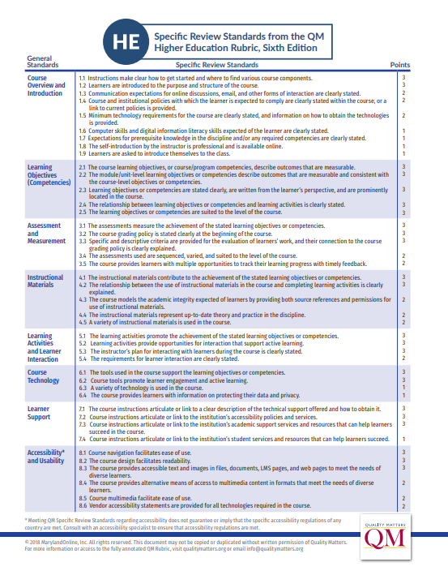
QM Rubric Eight General Standards
Course Overview and Introduction
Learning Objectives (Competencies)
Assessment and Measurement
Instructional Materials
Learning Activities and Learner Interaction
Course Technology
Learner Support
Accessibility and Usability

Slide 9
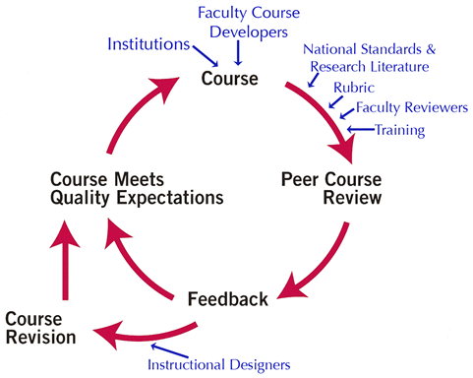
Peer Review Process
Faculty Self-review
The SWU Peer Review process is designed to ensure that courses undergoing review will eventually meet at least 85% of QM Standards (all essential standards).

Slide 10
As early as 2005, evidence of increased learner satisfaction after implementing course design improvements recommended by QM Peer Reviewers (PR) was measured by an end-of course evaluation. After the design improvements, learners were:
less confused about how to navigate the course and locate course requirements
expressed less concern about what they needed to succeed in the course
asked fewer procedural questions.
Learner input was gathered on course design issues relating to learner accessibility (QM Standard 8). Even learners who did not identify themselves as requiring specialized adaptive services noted the importance of a course being designed to meet the needs of all learners, including those who might need assistive technologies.
Statistics
Source Information: Shattuck, Kay. (2015, September). Research Inputs and Outputs of Quality Matters. Retrieved from https://www.qualitymatters.org/sites/default/files/research-docs-pdfs/QM-Research-What-We're-Learning-2015update.pdf.

Slide 11
Office of Instructional Design Professional Development List……
1
Building Learning Community with Teams – October 8, 2020
3
Importing Course Content Workshop – November, 2020
2
Review of the Online Course Development Template – October 20, 2020
4
Short Course: Inclusive Design – Spring 2021

Slide 13
Contact Information:
Email: bwilliamsonholley@swu.edu
Phone/Web Conference: Microsoft Office Teams

